Slide 1

MINI PROJECT – Line Following Robot DEC50122 DET 5C LECTURER NAME : ENCIK ISHAM SAHAR BIN ISMAIL
NAME | MATRIX NUMBER
MUHAMMAD FAISAL FAKHRUDDIN BIN AZIZAN | 03DET22F1003
CHE SYAHMI ZUHAIRI BIN CHE ZAHARI | 03DET22F1056
CHONG KHENG CHEN | 03DET22F1043

Slide 2
Introduction
This project focuses on designing and implementing a line-following robot that can navigate based on input from infrared (IR) sensors. The robot is controlled by an Arduino Nano and utilizes three infrared sensors to detect the line, along with DC motors for movement. A motor driver circuit is used to interface the Arduino with the motors, enabling it to steer the robot in various directions such as forward, left, right, reverse, or halt based on the sensor readings.
The robot's movement is determined by the status of the IR sensors in relation to the path it follows. Depending on the combination of sensor readings, which indicate whether the robot is aligned with the line or deviating from it, the Arduino adjusts the motor speeds and direction to correct the robot’s path. The simplicity of this system makes it ideal for demonstrating fundamental robotics concepts while maintaining a functional design for real-world applications.

Slide 3

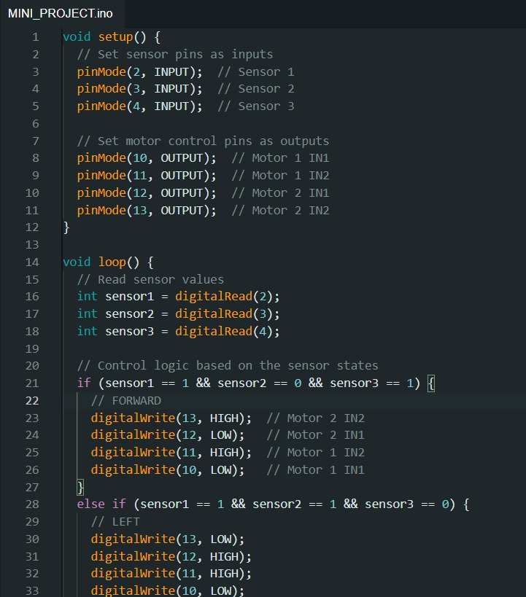
Block Diagram
Input
Microcontroller
Output
IR Sensor
Motor Driver (L298)
Arduino Nano
DC Motor
DC Motor

Slide 4
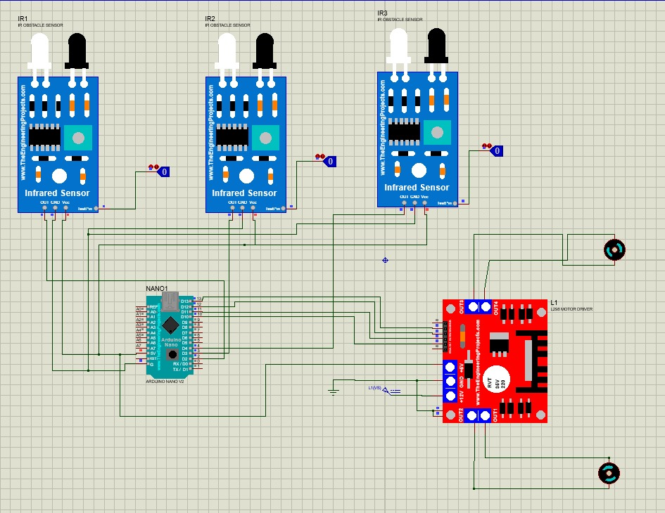
Schematic Diagram

Slide 5


Slide 6

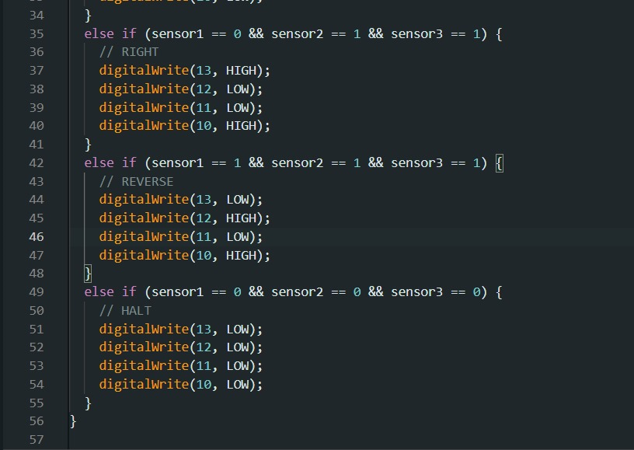
Program

Slide 7
Conclusion
Based on this mini project, we developed a line-following robot that showcased key robotics principles, including sensor integration, motor control, and path detection. They calibrated the sensors for accurate performance on various surfaces and implemented a PID control system to maintain consistent motor speeds and prevent drifting. A detailed truth table facilitated effective navigation through curves and intersections. The project combined simulation testing in Proteus with real-world trials for parameter fine-tuning. User balanced quality components with budget constraints by researching affordable parts and utilizing open-source resources. This project not only reinforced their understanding of robotics but also set the stage for future enhancements, such as obstacle detection and advanced decision-making algorithms.

